Slide 1
6CS005 High Performance Computing
Week 9A More OpenMP

Slide 2
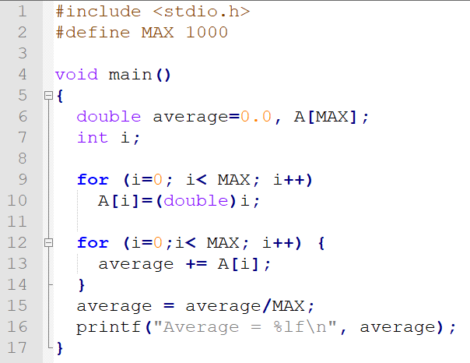

Averaging Program

Slide 3
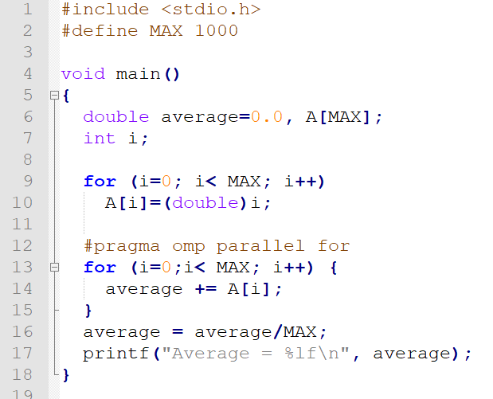

OpenMP Averaging Program

Slide 4
What happen?
Each thread tries to update the shared variable average at the same time creating a race condition
Can be solved with a critical section but this slows down the execution
Faster solution is for each thread to create it's own copy of the variable average and then combine them all at the end
This is called reduction

Slide 5
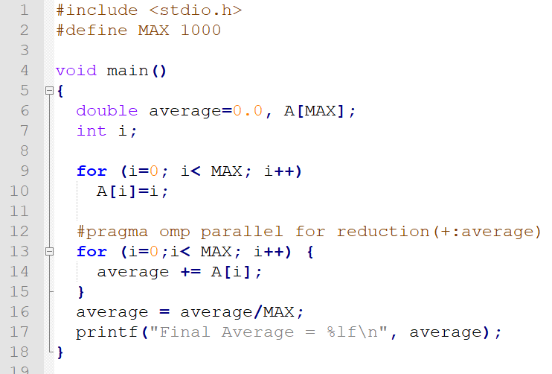

OpenMP Reduction

Slide 6
OpenMP Reduction
OpenMP reduction clause:
  reduction (op : list)
Inside a parallel or a work-sharing construct:
  A local copy of each list variable is made and initialized depending on the “op” (e.g. 0 for “+”).
  Updates occur on the local copy.
  Local copies are reduced into a single value and combined with the original global value.

Slide 7
OpenMP: Reduction operands/initial-values
Operator | Initial value
+ | 0
* | 1
- | 0
min | Largest pos. number
max | Most neg. number
& | ~0
| | 0
^ | 0
&& | 1
|| | 0
Many different associative operands can be used with reduction - Initial values are the ones that make sense mathematically.

Slide 8
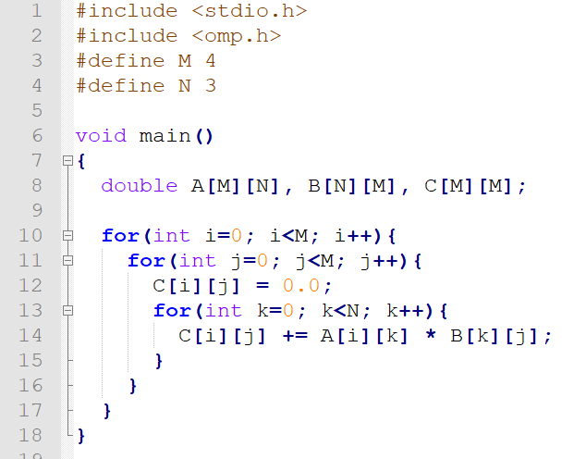
Matrix Multiplication

Slide 9
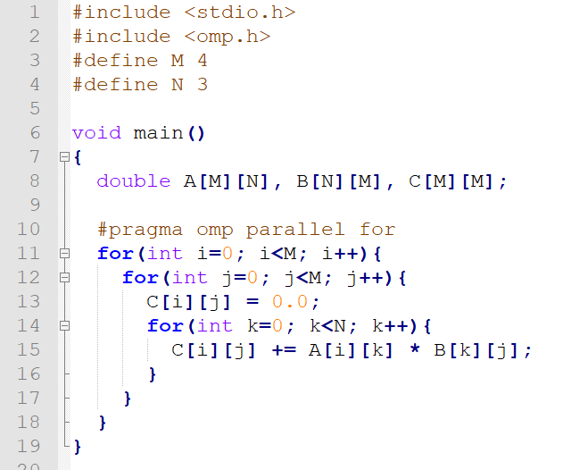
OpenMP Parallel For
Limited by size of loop

Slide 10
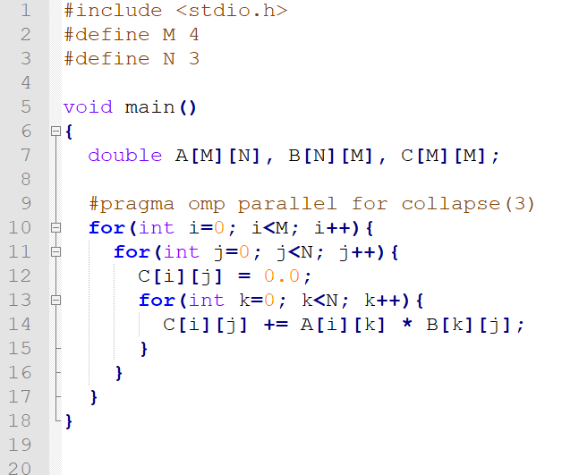
Collapsing loops in OpenMP
Collapse the 3 loops
into one internally
M

Slide 11
Limitations of the "for" directive
Some for loops cannot be parallelised.
OpenMP can only parallelise for loops that have pre-determined iterations
It cannot work with for loops that may terminate early, e.g.
  for (i = 0; i < n; i++) {
  if ( . . . ) break;
  . . .
  }

Slide 12
OpenMP Simple Locks
Directly comparable to pthread mutexes:
  omp_init_lock() initializes a simple lock
  omp_destroy_lock() uninitializes a simple lock
  omp_set_lock() waits until a simple lock is available and then sets it
  omp_unset_lock() unsets a simple lock
  omp_test_lock() tests a simple lock and sets it if it is available
  omp_lock_t represents a simple lock type

Slide 13
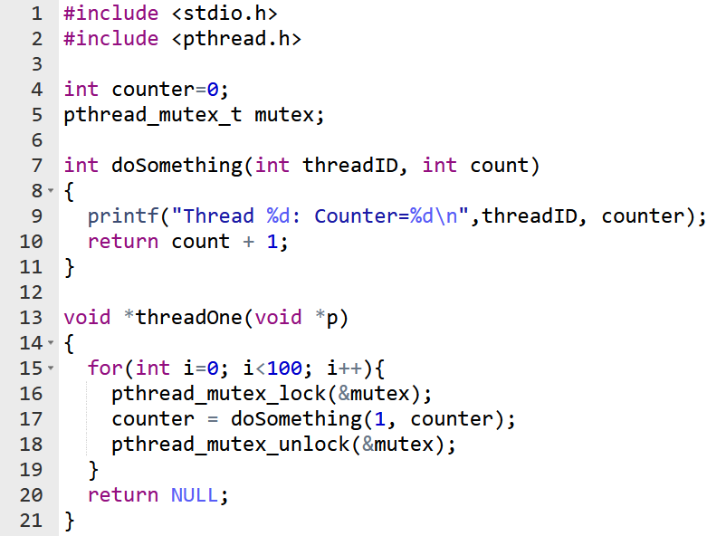
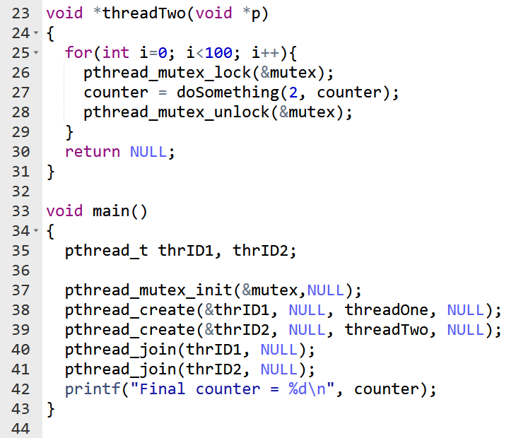
Pthread Mutex

Slide 14
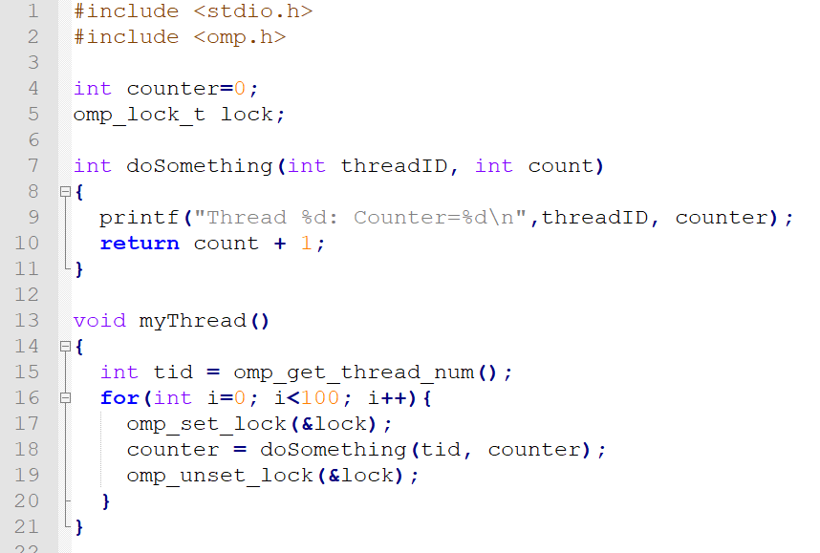
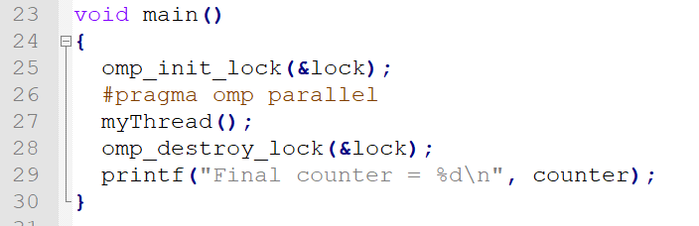
OpenMP Equivalent

Slide 15
OpenMP Sections
The OpenMP sections are a set of structured blocks that are to be distributed among and executed by the threads in a team.
Each structured block is executed once by any one of the threads in the team

Slide 16
OpenMP Sections
void main()
{
#pragma omp parallel
{
#pragma omp sections
{
#pragma omp section
{
printf ("Section 1 Thread ID = %d\n", omp_get_thread_num());
}
#pragma omp section
{
printf ("Section 2 Thread ID = %d\n", omp_get_thread_num());
}
#pragma omp section
{
printf ("Section 3 Thread ID = %d\n", omp_get_thread_num());
}
}
}
}

Slide 17
OpenMP master directive
The master directive denotes a structured block that is only executed by the master thread.
The other threads just skip it
#pragma omp parallel
{
#pragma omp master
{
printf ("Line 1 Thread ID = %d***\n", omp_get_thread_num());
}
printf ("Line 2 Thread ID = %d\n", omp_get_thread_num());
printf ("Line 3 Thread ID = %d\n", omp_get_thread_num());
printf ("Line 4 Thread ID = %d\n", omp_get_thread_num());
}

Slide 18
OpenMP single directive
The single directive denotes a structured block that is only executed by just any one thread.
A barrier is implied at the end of the "single" block
#pragma omp parallel
{
printf ("Line 1 Thread ID = %d\n", omp_get_thread_num());
#pragma omp single
{
printf ("Line 2 Thread ID = %d***\n", omp_get_thread_num());
}
printf ("Line 3 Thread ID = %d\n", omp_get_thread_num());
printf ("Line 4 Thread ID = %d\n", omp_get_thread_num());
}

Slide 19
Common OpenMP Functions
void omp_set_num_threads(int num_threads)
  Sets the number of threads to be used in the next parallel block
int omp_get_num_threads()
  Gets the current number of threads
int omp_get_thread_num()
  Gets the current thread ID
int omp_get_max_threads()
  Gets the maximum number of threads available
int omp_get_num_procs()
  Gets the number of processors in the system
int omp_in_parallel()
  Are we in an active parallel region?

Slide 20
OpenMP Pros
Portable multithreading code.
Data layout and decomposition is handled automatically by directives.
Incremental parallelism: can work on one part of the program at one time, no dramatic change to code is needed.
Unified code for both serial and parallel applications: OpenMP constructs are treated as comments when sequential compilers are used.
Original (serial) code statements need not, in general, be modified when parallelized with OpenMP.
Both coarse-grained and fine-grained parallelism are possible.
Can be used on various accelerators such as GPGPU and FPGAs

Slide 21
OpenMPI Cons
Risk of introducing difficult to debug synchronization bugs and race conditions.
Only runs efficiently in shared-memory multiprocessor platforms.
Requires a compiler that supports OpenMP.
Scalability is limited by memory architecture.
Reliable error handling is missing.
Lacks fine-grained mechanisms to control thread-processor mapping.
High chance of accidentally writing false sharing code.

Slide 22
End

